Slide 1
Lecture 50
Resolution and Polariztion

Slide 2
Question 223.19.1
Resolution is
The ending argument in a debate
The ability to distinguish separate point sources in an optical image
The distance between bright fringes in a diffraction pattern
The distance between dark fringes in a diffraction pattern

Slide 3
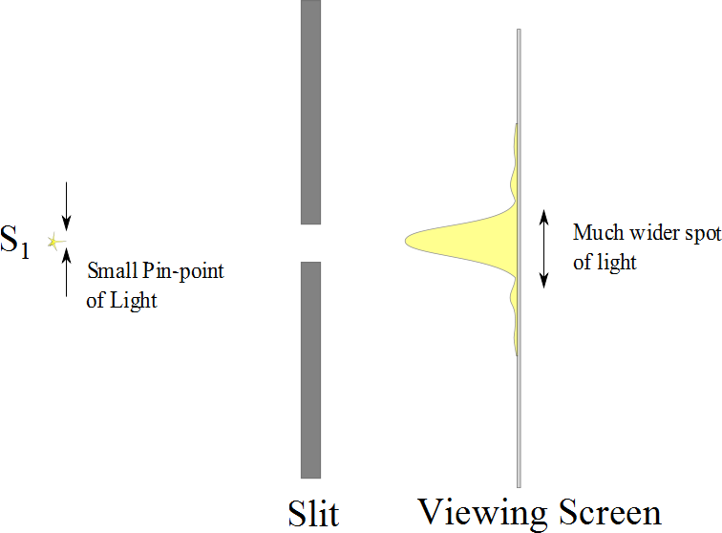

Slide 4
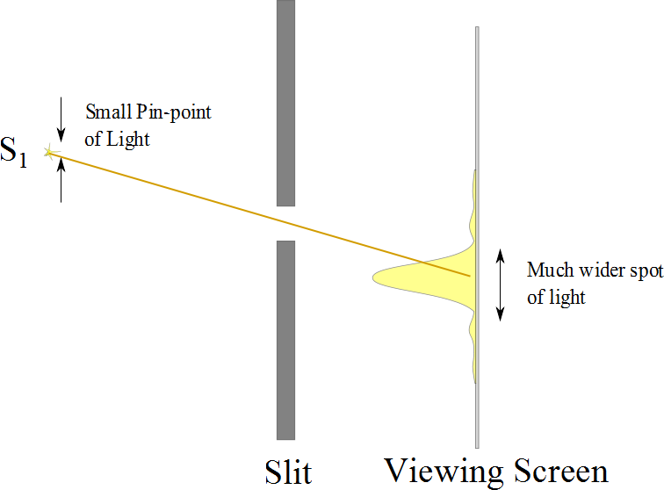

Slide 5
Resolution

Slide 6
Resolution
The ability of optical systems to distinguish between closely spaced objects is limited because of the wave nature of light
If two sources are far enough apart to keep their central maxima from overlapping, their images can be distinguished
The images are said to be resolved
If the two sources are close together, the two central maxima overlap and the images are not resolved

Slide 7
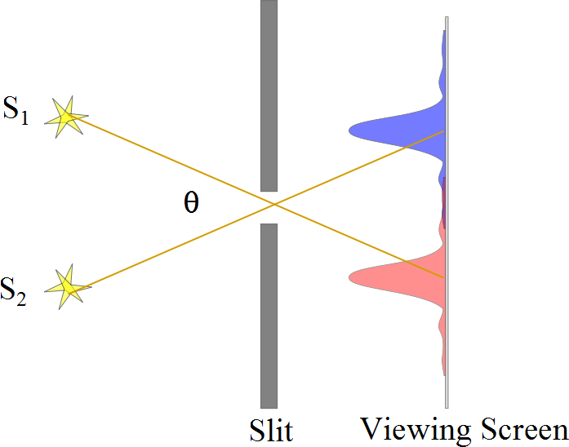
Resolved Images, Example

Slide 8
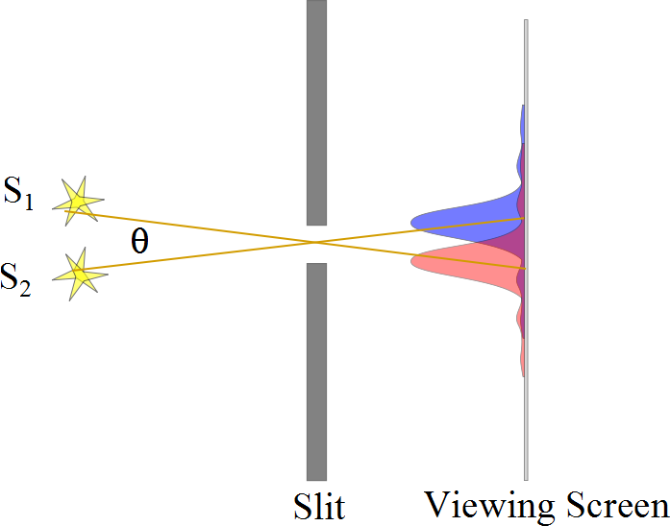
Barely Resolved, Example

Slide 9
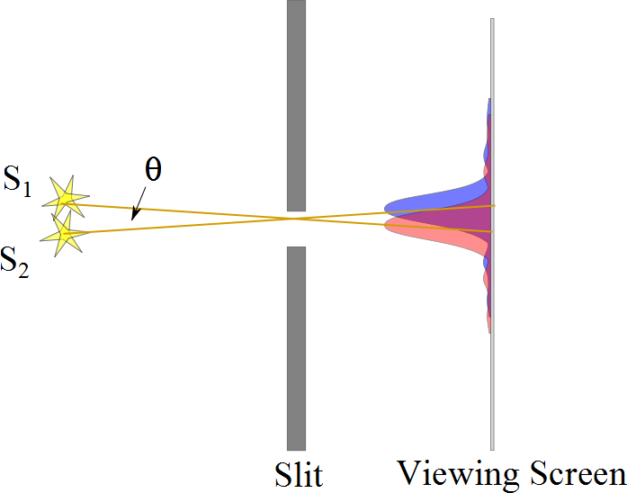
Images Not Resolved, Example

Slide 10
Resolution
The ability of optical systems to distinguish between closely spaced objects is limited because of the wave nature of light
If two sources are far enough apart to keep their central maxima from overlapping, their images can be distinguished
The images are said to be resolved
If the two sources are close together, the two central maxima overlap and the images are not resolved

Slide 12
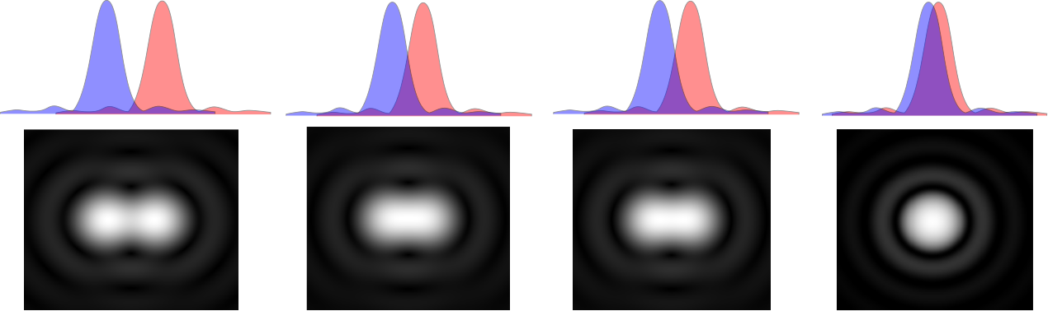

Slide 14
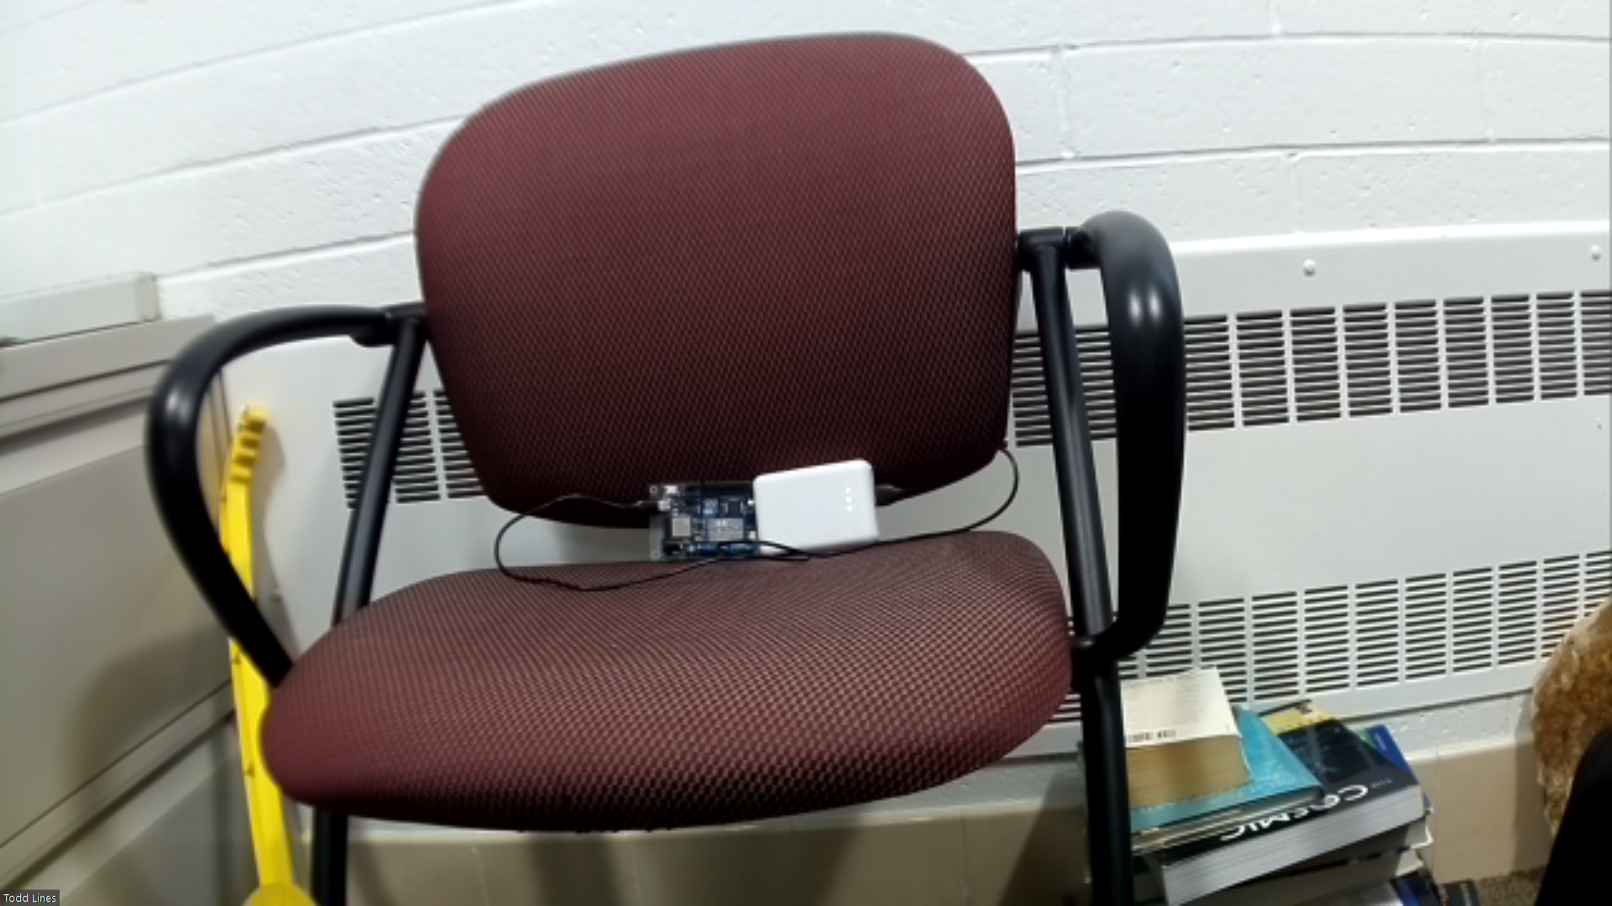
RPHD Camera L=1.3
1.5
D=4mm

Slide 15
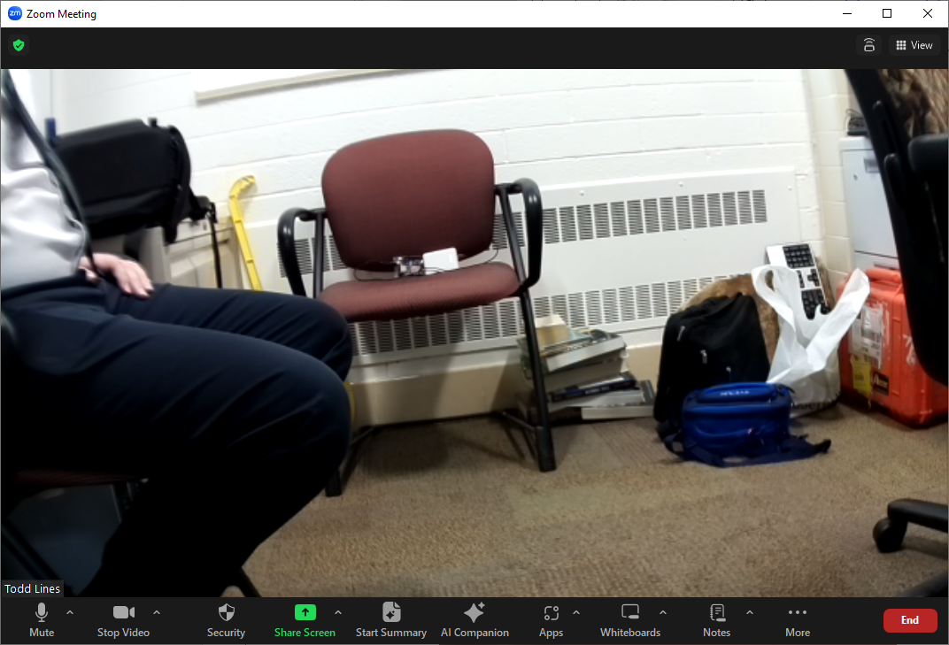
RPHD Camera L=2.5
1.5
D=4mm

Slide 16
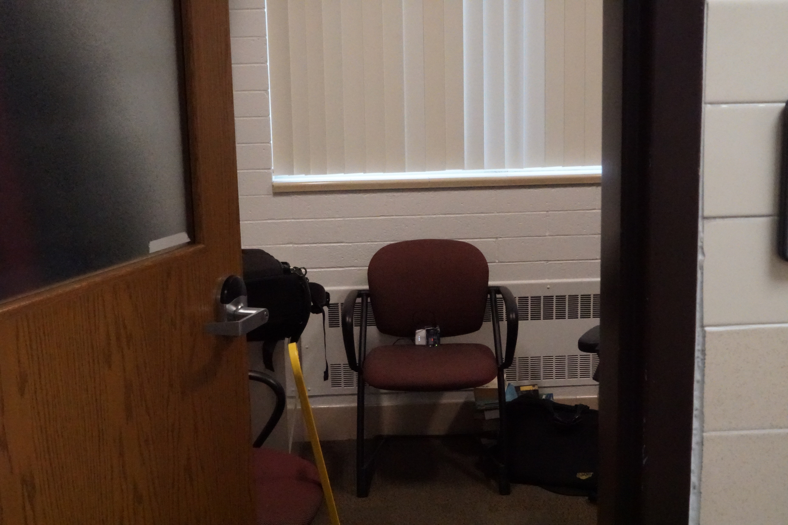
Tamron L= 9m
F16
D=4mm
ISO 3200

Slide 17
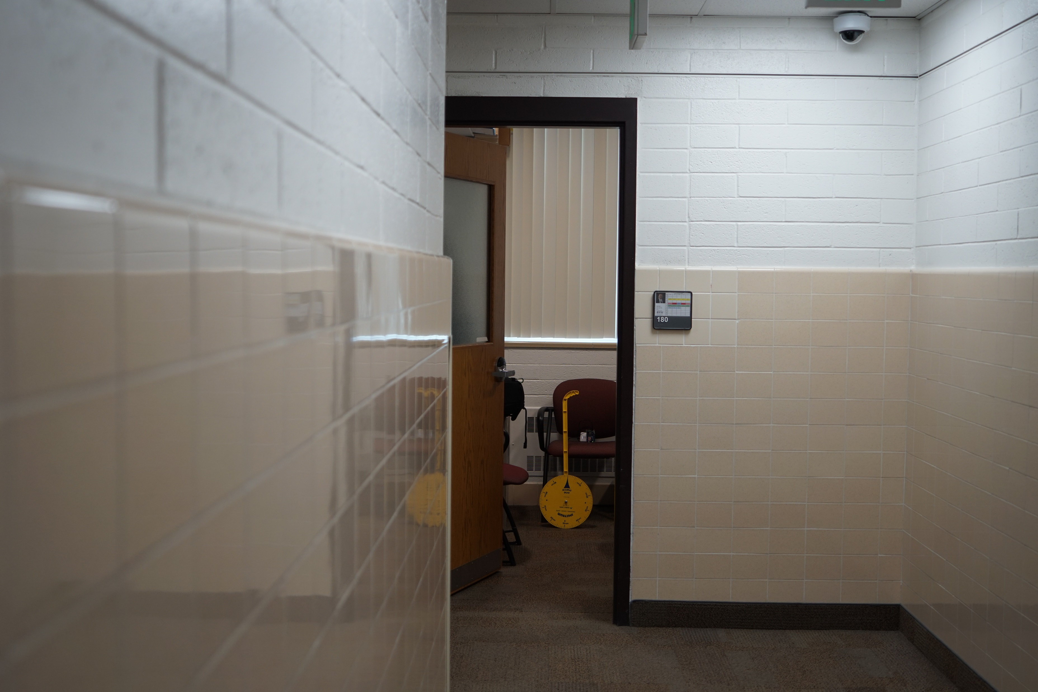
Tamron L= 9m
F2.8
D=67mm
ISO 400

Slide 18
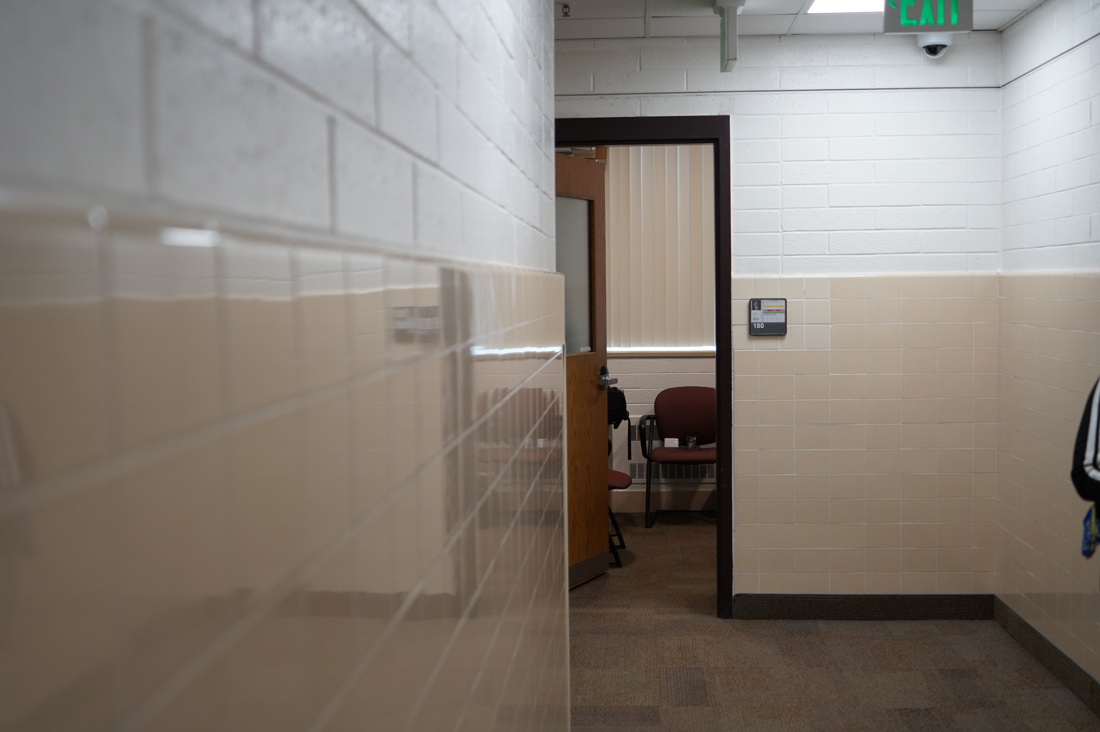
Tamron L= 10m
F16
D=4mm
ISO 3200

Slide 19

Tamron L= 10m
F2.8
D=67mm
ISO 400

Slide 20
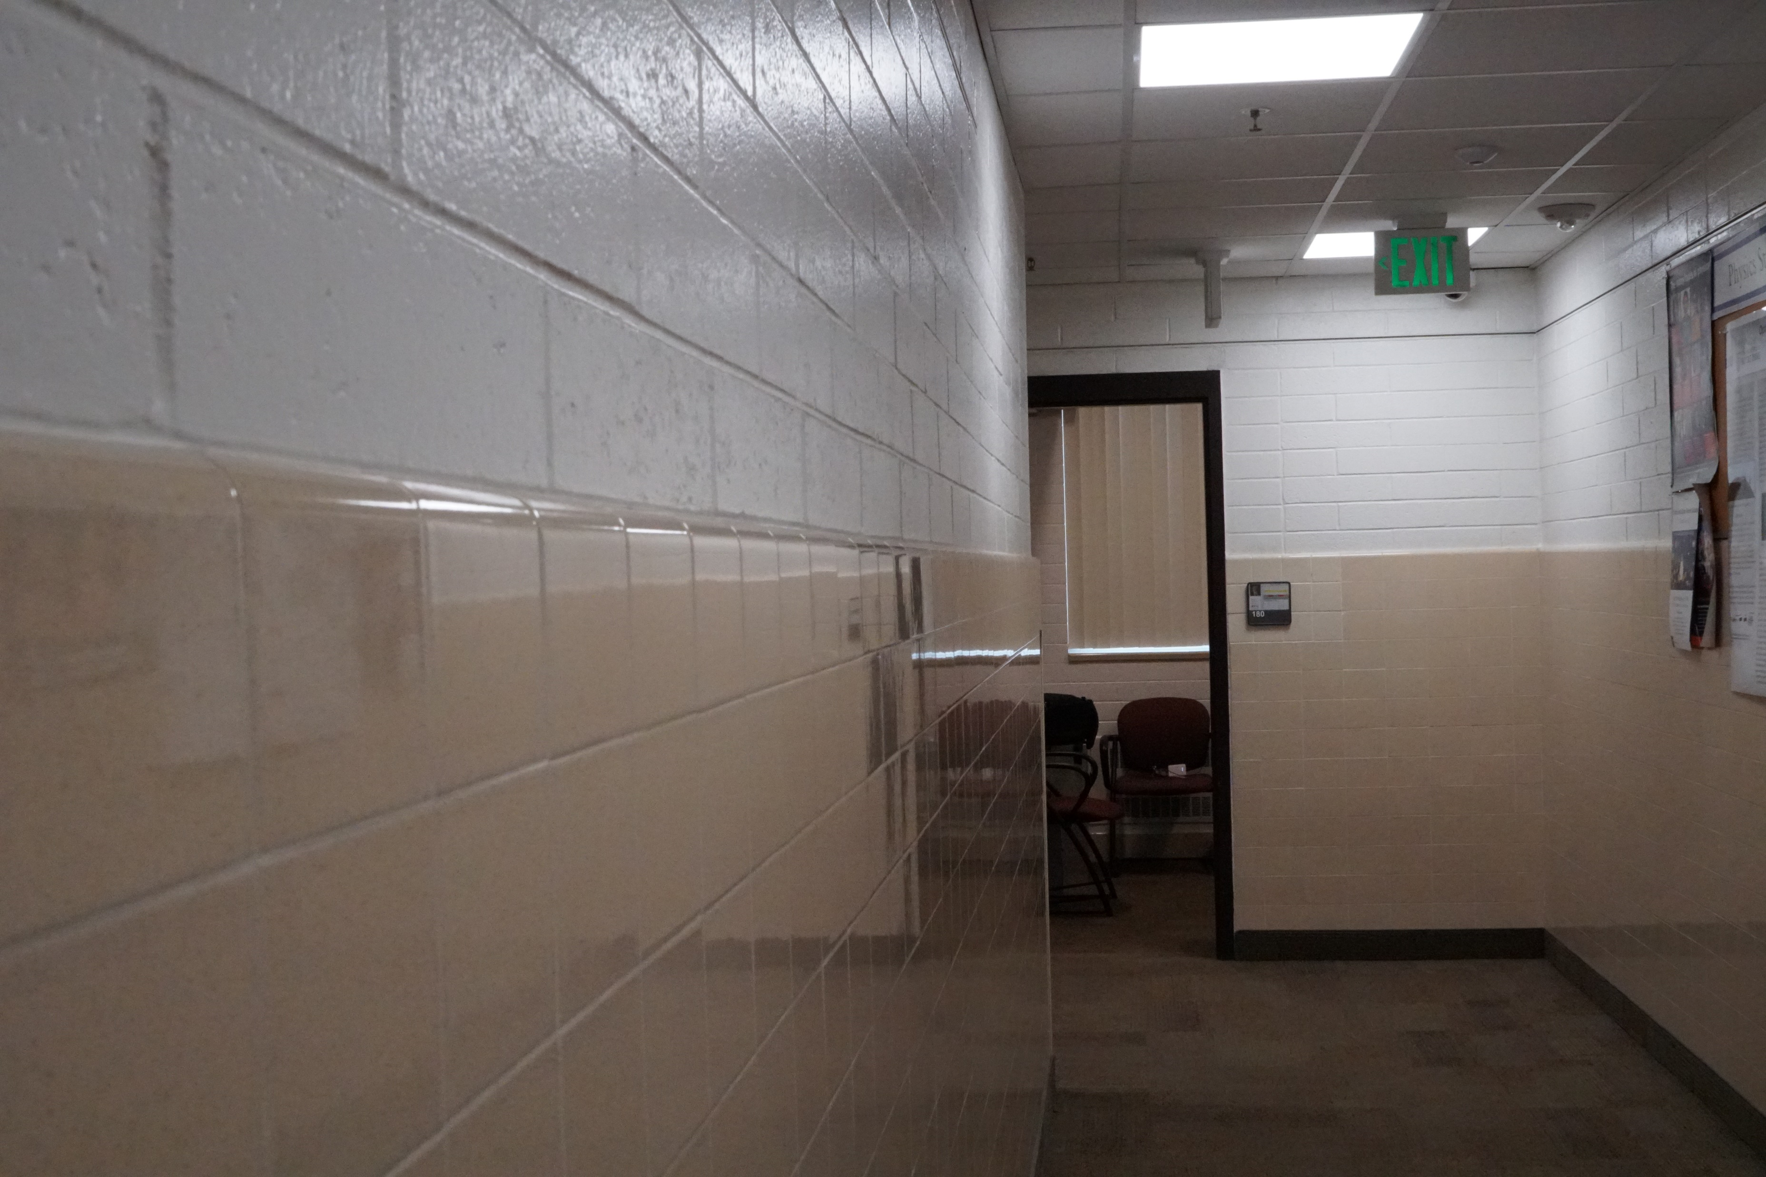
Tamron L= 11m
F16
D=4mm
ISO 3200

Slide 21
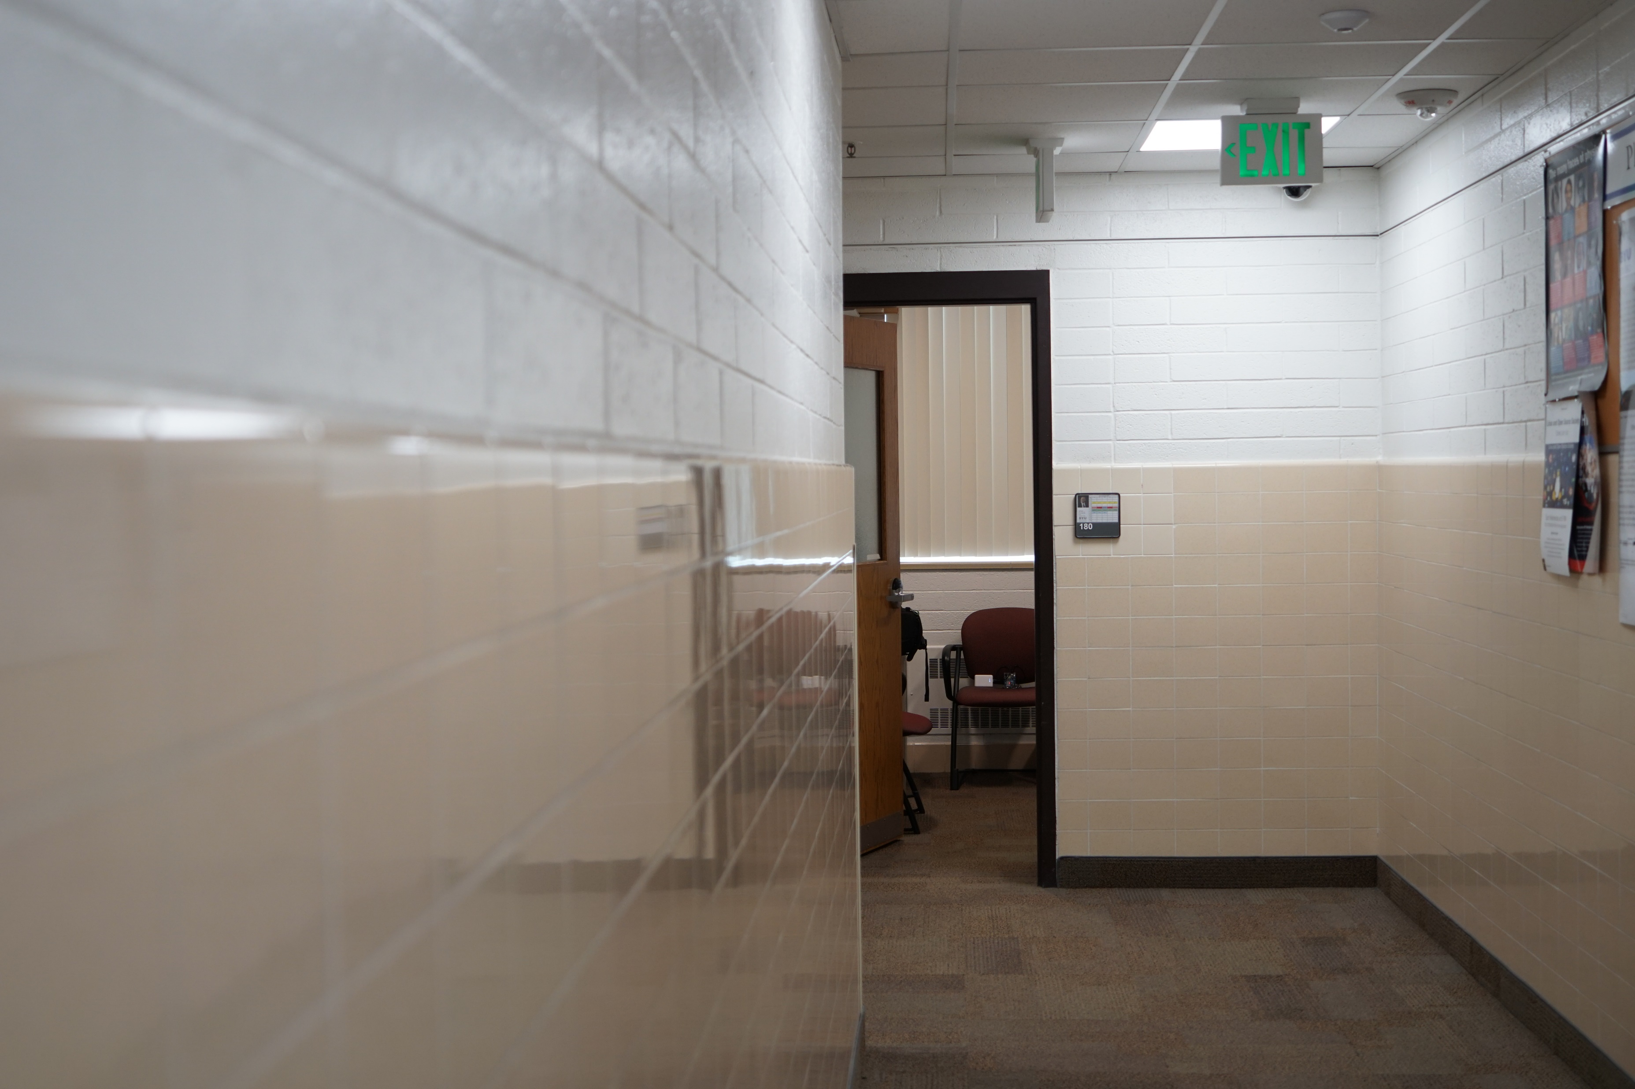
Tamron L=11m
F2.8
D=67mm
ISO 400

Slide 22
Question 233.19.2
Cat’s eyes have pupils that can be modeled as vertical slits. At night, would cats be more successful in resolving
Headlights on a distant car
Vertically separated lights on the mast of a distant boat?

Slide 23
Resolution, Rayleigh’s Criterion
When the central maximum of one image falls on the first minimum of another image, the images are said to be just resolved
This limiting condition of resolution is called Rayleigh’s criterion

Slide 24
Resolution, Rayleigh’s Criterion, Equation
The angle of separation, θ_{min}, is the angle subtended by the sources for which the images are just resolved
Since λ << a in most situations, sin θ is very small and sin θ ≈ θ
Therefore, the limiting angle (in rad) of resolution for a slit of width a is
To be resolved, the angle subtended by the two sources must be greater than θ_{min}

Slide 25
Circular Apertures
The diffraction pattern of a circular aperture consists of a central bright disk surrounded by progressively fainter bright and dark rings
The limiting angle of resolution of the circular aperture is
D is the diameter of the aperture

Slide 26
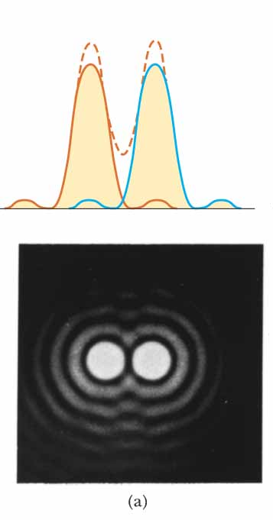
Circular Apertures, Well Resolved
The sources are far apart
The images are well resolved
The solid curves are the individual diffraction patterns
The dashed lines are the resultant pattern

Slide 27
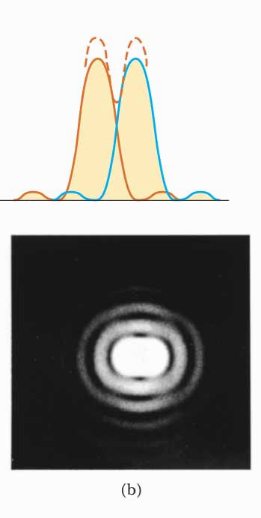
Circular Apertures, Just Resolved
The sources are separated by an angle that satisfies Rayleigh’s criterion
The images are just resolved
The solid curves are the individual diffraction patterns
The dashed lines are the resultant pattern

Slide 28
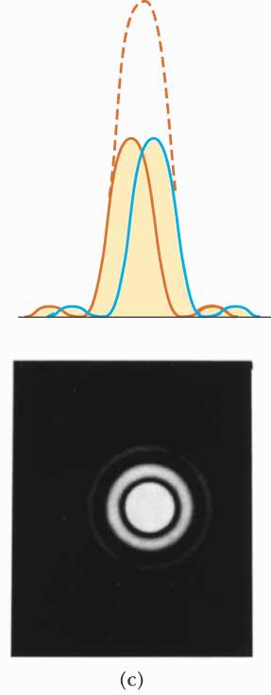
Circular Apertures, Not Resolved
The sources are close together
The images are unresolved
The solid curves are the individual diffraction patterns
The dashed lines are the resultant pattern

Slide 29
Completely Resolved
Rayleigh Criterion
Sparrow Criterion
Unresolved

Slide 30
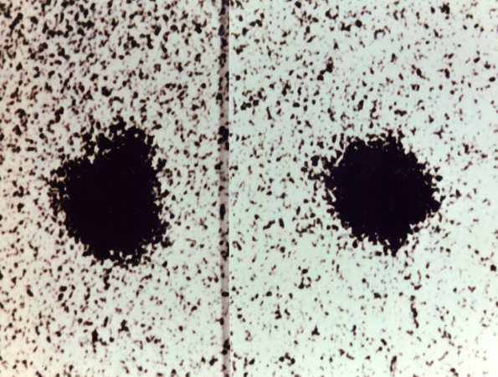
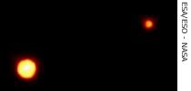
Resolution, Example
Charon
Pluto
Pluto and its moon, Charon
Left: Earth-based telescope is blurred
Right: Hubble Space Telescope clearly resolves the two objects

Slide 31
Question 223.50.1
Which of the following is Faraday’s law?
a)
b)
c)
d)

Slide 32
Question 223.50.2
Which of the following is Gauss’s law?
a)
b)
c)
d)

Slide 33
Question 223.50.3
Which of the following is Ampere’s law?
a)
b)
c)
d)

Slide 34
Question 223.50.4
Which of the following is Faraday’s law?
a)
b)
c)
d)

Slide 35
Question 223.50.1
Which of the following is Gauss’s law for magnetic fields?
a)
b)
c)
d)

Slide 36
Question
We drew the E and B fields along a path from a source like this:
Is the E-field always vertical
From a light source?
Yes
No
Maybe

Slide 37
E

Slide 38
E

Slide 39
Question
What do we call a light wave that has an E-filed that oscillates in just one direction?
Confined
Polarized
Linear
Confocal
E

Slide 40
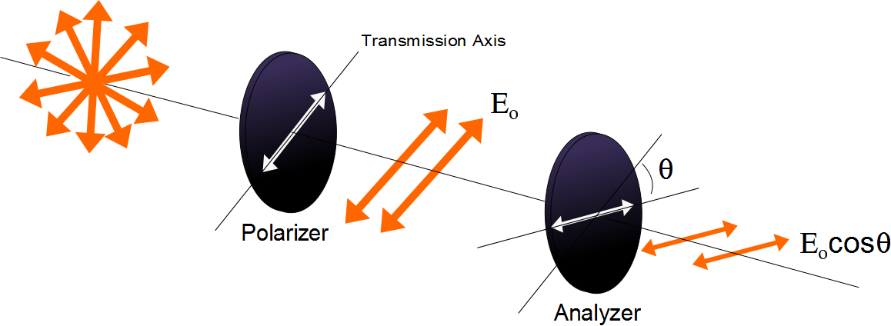

Slide 41
Question
I have two polarizers. If I pass light through both of them and their axes are aligned at 90 degrees from each other how much of the original light comes through?
All of it
30%
70%
None of it

Slide 42
E
Incident Beam
Reflected Beam
θ₁
θ₁
n₁
n₂
Transmitted Beam
θ₂

Slide 43
E
Reflected Beam
Has only the
perpendicular
polarization
Incident Beam
θ_{b}
θ_{b}
n₁
90°
n₂
Transmitted Beam
θ₂

Slide 44
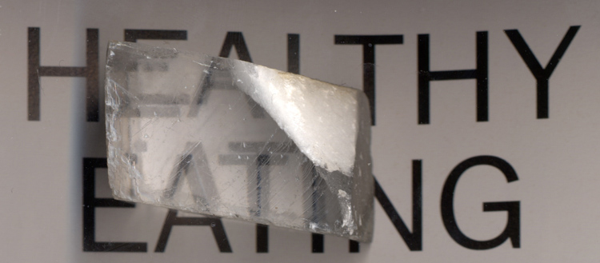

Slide 45
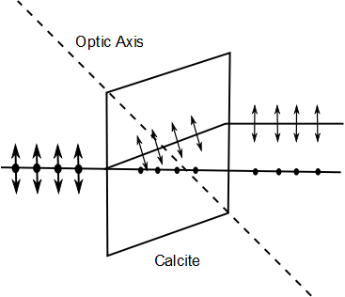
E-ray
Unpolarized Light
O-ray

Slide 46
Polarization by Double Refraction, Rays
The ordinary (O) ray is characterized by an index of refraction of n_{o}
This is the same in all directions
The second ray is the extraordinary (E) ray which travels at different speeds in different directions
Characterized by an index of refraction of n_{E} that varies with the direction of propagation

Slide 47
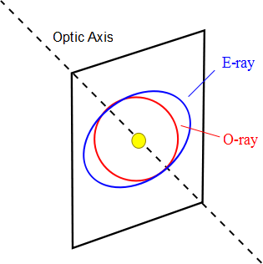

Slide 48
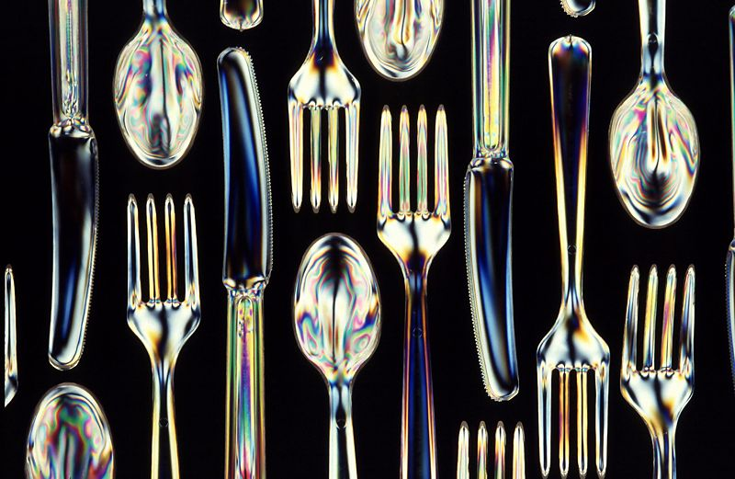
Optical Stress Analysis

Slide 49
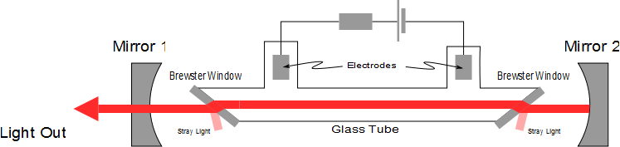
Laser Polarization

Slide 50
End

